Slide 1

Advanced course
Lesson 24（2）
DIY coures
Fruit piano
YahBoom Croco:Kit tutorial

Slide 2
Advanced course
Content
Part1
Part 2
Part3
Part 4
Part 5
Learning goals
Preparation
Connection
Search for blocks
Combine blocks
YahBoom Croco:Kit tutorial

Slide 3
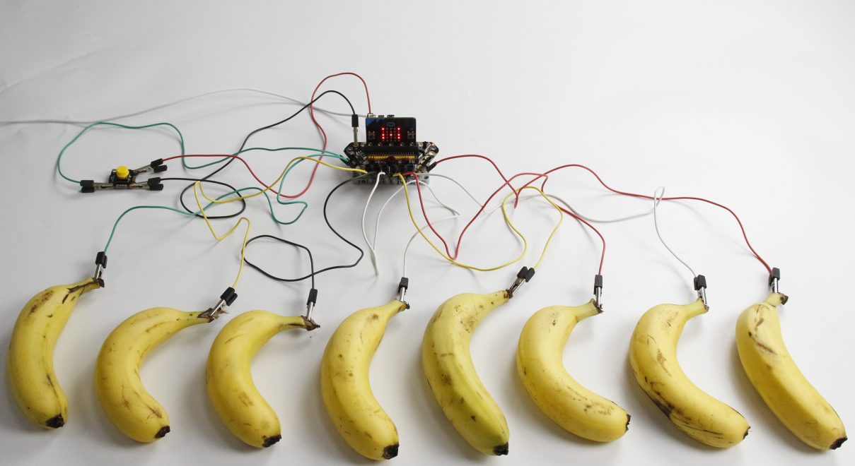
Advanced course
Part 1
Learning goals
After downloading the program, we can see the word 'Happy Birthday!' on the Micro:bit LED dot matrix. Then Micro:bit LED dot matrix display M, which is the middle tone. When we prese button, can switch to L or H tone.
YahBoom Croco:Kit tutorial

Slide 4
Advanced course
Part 2
Hardware:
● 1 X Micro:bit Board
● 1 X Micro USB Cable
● 1 X Diamond breakout
● 8 X Fruits
● 1 X Button module
● 11 X Alligator clip
● 1 X PC
Preparation
Mode 1 online programming: First, we need to connect the micro:bit to the computer by USB cable. The computer will pop up a USB flash drive and click on the URL in the USB flash drive: http://microbit.org/ to enter the programming interface. Add the Yahboom package: https://github.com/lzty634158/Croco-Kit to program.
Mode 2 offline programming: We need to open the offline programming software. After the installation is complete, enter the programming interface, click【New Project】, add Yahboom package: https://github.com/lzty634158/Croco-Kit , you can program.
YahBoom Croco:Kit tutorial

Slide 5
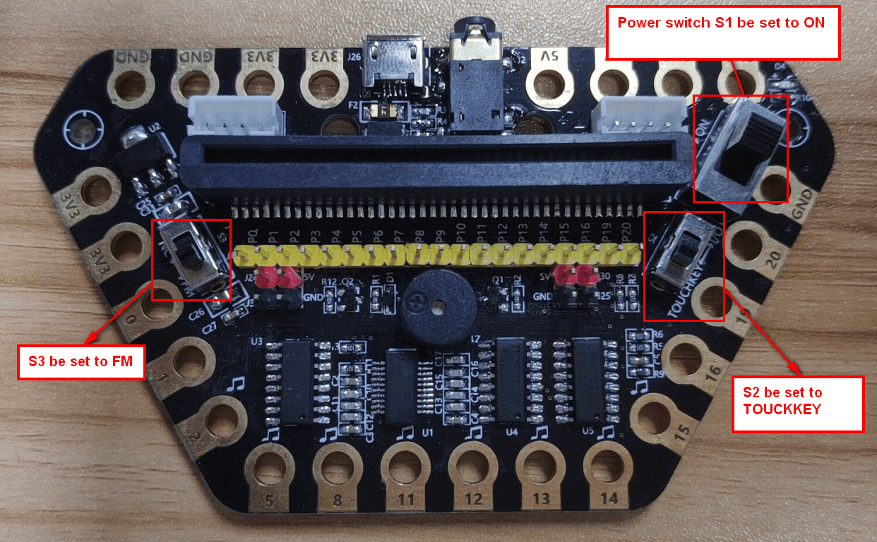
Advanced course
Part 2
Preparation
! ! !Note: S1 be set to the ON, S2 be set to theTOUCKKEY, and S3 to the FM.
YahBoom Croco:Kit tutorial

Slide 6
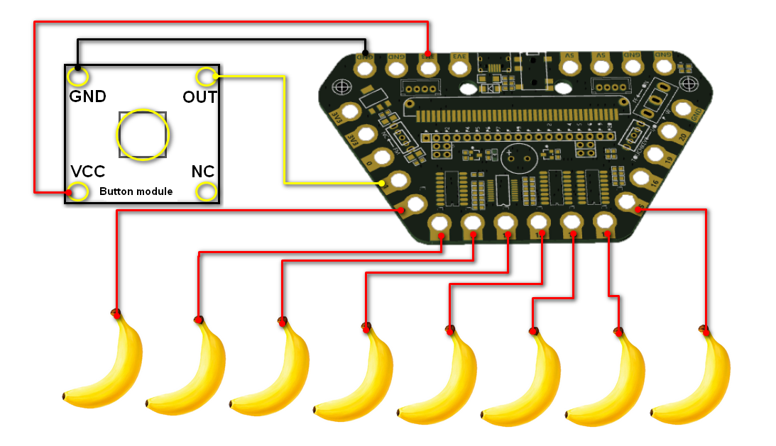
Advanced course
Part 3
Expansion board | Button Module | Fruit
P1 | OUT
3.3V | VCC
GND | GND
P2、P5、P8、P11、P12、P13、P14、P15 |  | 8 X Fruits
Connection
YahBoom Croco:Kit tutorial

Slide 7
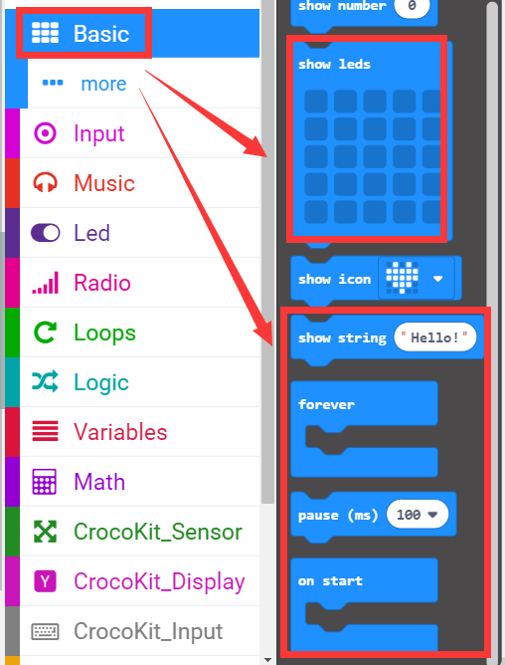
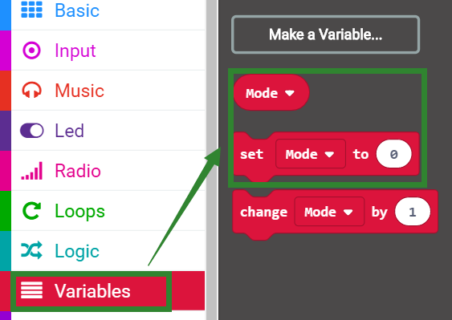
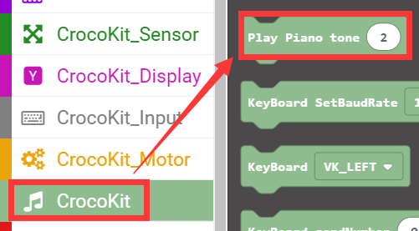
Advanced course
Part 4
Search for blocks
YahBoom Croco:Kit tutorial

Slide 8
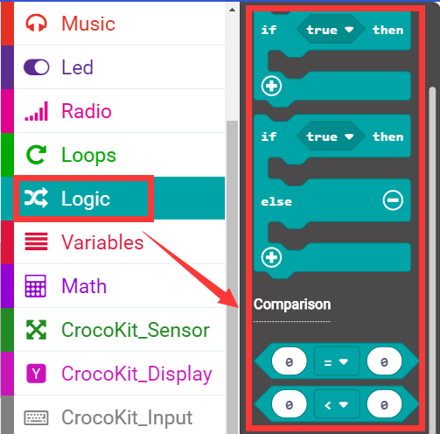
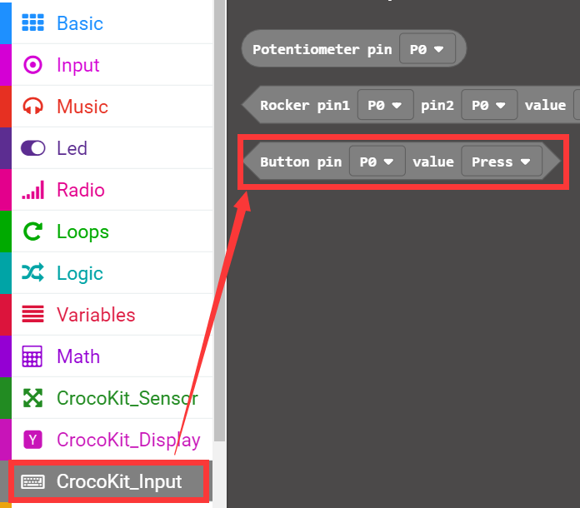
Advanced course
Part 4
Search for blocks
YahBoom Croco:Kit tutorial

Slide 9
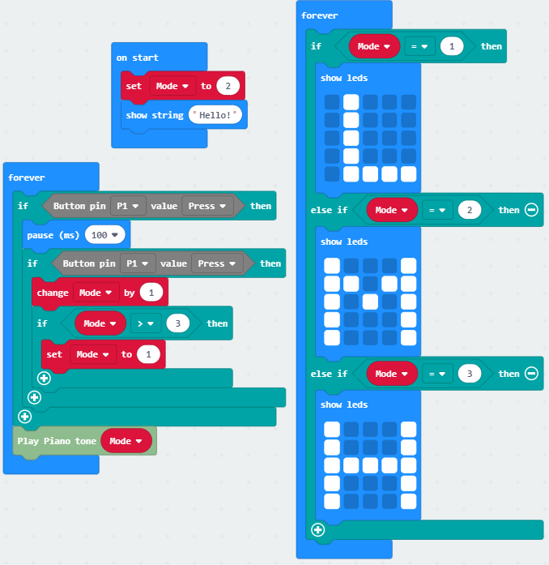
Advanced course
Part 5
Combine blocks
YahBoom Croco:Kit tutorial

Slide 10
Advanced course
Thank you ！
Powered by YahBoom
YahBoom Croco:Kit tutorial

